Slide 1
JSP Examples
Ashutosh Pandey
Asstt. Professor
CSE Dept

Slide 2
Start.jsp
<html>
<head>
<Title>First JSP Page</Title></head>
<body>
Hello! the Time is now <%= new java.util.Date() %>
</body>
</html> Show JSP Page

Slide 3
JSP Examples Cont………
Declaration.jsp
<%@ page import="java.util.*" %>
<html>
<head>
<Title>Declaration JSP Page</Title></head>
<body>
<%!
Date theDate = new Date();
Date getDate()
{
System.out.println("In getDate() method");
return theDate;
}
%>
Hello! the Time is now <%= getDate() %>
</body>
</html>
Show Declaration.jsp

Slide 4
JSP Examples Cont………
Directives.jsp
<%@ page import="java.util.*" %>
<html>
<head>
<Title>Directives JSP Page</Title></head>
<body>
<%
System.out.println("Evaluating date now");
Date date = new Date();
%>
Hello! the Time is now <%= date %>
</body>
</html> Show Directives.jsp

Slide 5
JSP Examples Cont………
Scriptlet.jsp
<html>
<head>
<Title>JSP Page using Scriptlet</Title></head>
<body>
<%
System.out.println("Evaluating date now");
java.util.Date date = new java.util.Date();
%>
<h1>Hello! the Time is now <%= date %></h1>
</body>
</html> Show Scriptlet.jsp

Slide 6
JSP Examples Cont………
GetName.html
<html>
<head>
<Title>Taking User Input with HTML Page</Title></head>
<body>
<form method=POST Action="SaveName.jsp">
What's your Name? <input type=text name=username size=20>
<p>
<input type= SUBMIT>
</form>
</body>
</html> Show Welcome Html Page

Slide 7
JSP Examples Cont………
SaveName.jsp
<%
String name= request.getParameter("username");
session.setAttribute("theName", name);
%>
<html>
<head>
<Title>Processing User Input and Forwarding to Next Page</Title></head>
<body>
<h2>Now you are at SaveName.jsp Page</h2>
</br>
<a href="NextPage.jsp"> Continue....</a>
</body>
</html>

Slide 8
JSP Examples Cont………
NextPage.jsp
<html>
<head>
<Title>showing session Attribute Page</Title></head>
<body>
<h2>Now you are at NextPage.jsp Page</h2>
</br>
<% session.getAttribute(“name”); %>
</body>
</html>

Slide 9
So, What is a Design Pattern Anyway?
First of all, let's define what a design pattern is. There are a number of formal definitions, but I prefer a simple approach: a design pattern is simply a description of a recurring solution to a problem, given a context.
Simple enough. The context is the environment, surroundings, situation, or interrelated conditions within which the problem exists. Design patterns have a number of advantages, among which are:
They capture engineering experience.
Once described, any level engineer can use the pattern.
They allow for reuse without having to reinvent the wheel on a project-by-project basis.
They allow for us, as engineers, to better define system structure.
They provide a design vocabulary.
They also provide reusable artifacts.

Slide 10
It is a rare instance (although not an impossible one), that a design pattern is used in an isolated fashion. Typically, patterns have relationships and work together to form a weave, in that a pattern can be composed of, or rely on, other patterns. That is why you will see that the more familiar you are with different patterns, the better equipped you are to determine their interactions. Patterns can also form frameworks that can then be used for implementations.
Enterprise systems are built crossing many tiers; this should not be news to anyone reading this article. This discussion is focused on the presentation tier, and primarily covers patterns that can be used with JSP and Servlet technology.

Slide 11
Show Me Your Pattern
There are a number of patterns that have been identified by the Sun Java Center for the presentation tier. These are certainly not the only patterns that can be applied, but they are a good starting point. The presentation patterns take into consideration the logic required to service clients that access the system. This includes client requests, single sign-on, session management, access to business services, as well as the creation, formatting, and delivery of responses to the client.

Slide 12
These patterns include:
Intercepting Filter: facilitates preprocessing and post-processing of a request.
Front Controller: provides a centralized controller for managing the handling of requests.
View Helper: encapsulates logic that is not related to presentation formatting into Helper components.
Composite View: creates an aggregate View from atomic subcomponents.
Service To Worker: combines a Dispatcher component with the Front Controller and View Helper patterns.
Dispatch View: combines a Dispatcher component with the Front Controller and View Helper patterns, deferring many activities to View processing.

Slide 13
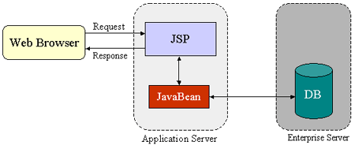
JSP Design Pattern
Integrating Servlets and JSP Pages
The JSP specification presents two approaches for building web applications using JSP pages: JSP Model 1 and Model 2 architectures. These two models differ in the location where the processing takes place. In Model 1 architecture, as shown in Figure 1, the JSP page is responsible for processing requests and sending back replies to clients.
Figure 1: JSP Model 1 Architecture

Slide 14
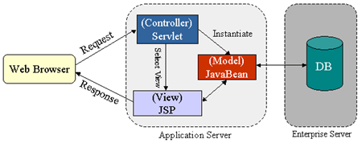
JSP Design Pattern
The Model 2 architecture, as shown in Figure 2, integrates the use of both servlets and JSP pages. In this mode, JSP pages are used for the presentation layer, and servlets for processing tasks. The servlet acts as a controller responsible for processing requests and creating any beans needed by the JSP page. The controller is also responsible for deciding to which JSP page to forward the request. The JSP page retrieves objects created by the servlet and extracts dynamic content for insertion within a template.
Figure 2: JSP Model 2 Architecture

